Slide 1
Lead Scoring Case Study
Submitted by
Fauziya A Rahim

Slide 2
Table of contents
Problem Statement:
Solution Summary:
Step 1 : Importing Libraries and Data
Step 2 : Data Inspection
Step 3: Data Cleaning:
Step 4: EDA:
Step 5: Data Preparation:
Step 6: Test-Train Split
Step 7: Feature Scaling
Step 8: Model Building:
Step 9: Model Evaluation:
Step 10: Making Predictions on Test Data:
Recommendations:

Slide 3
Problem Statement:
X Education gets a lot of leads, the typical lead conversion rate at is around 30% which is very poor. The company requires us to build a model wherein we need to assign a lead score to each of the leads such that the customers with a higher lead score have a higher conversion chance and the customers with a lower lead score have a lower conversion chance. The CEO, in particular, has given a ballpark of the target lead conversion rate to be around 80%.

Slide 4
Solution Summary
Step 1 : Importing Libraries and Data
Step 2 : Data Inspection
Step 3: Data Cleaning:
Step 4: EDA:
Step 5: Data Preparation:
Step 6: Test-Train Split
Step 7: Feature Scaling
Step 8: Model Building:
Step 9: Model Evaluation:
Step 10: Making Predictions on Test Data:

Slide 5
Step 1 : Importing Libraries and Data
Import necessary libraries such as Pandas and NumPy,Sklearn libraries,statmodel libraries,Importing lead dataset

Slide 6
Step 2 : Data Inspection
The dataframe has 9240 rows and 37 columns
There are no duplicates in the dataframe.
There are few columns with high number of missing/null values in the dataframe.

Slide 7
Step 3: Data Cleaning:
3.1: 'Select' values
There are 'Select' values in many columns.It may be because the customer did not select any option from the list, hence it shows 'Select'.'Select' values are as good as NULL. So we can convert these values to null values.
3.2: Handling Missing Values
3.2.1 : Drop Columns with more than 40% Null Values
3.2.2 : Columns with Categorical Data
Dropped the following columns-City,Tags,Country ,What matters most to you in choosing a course:
Imputed the following columns- Specialization, Lead Source, Last Activity, What is your current occupation
3.2.3 : Columns with Numerical Data is checked
3.3 : Removing Unwanted Columns

Slide 8
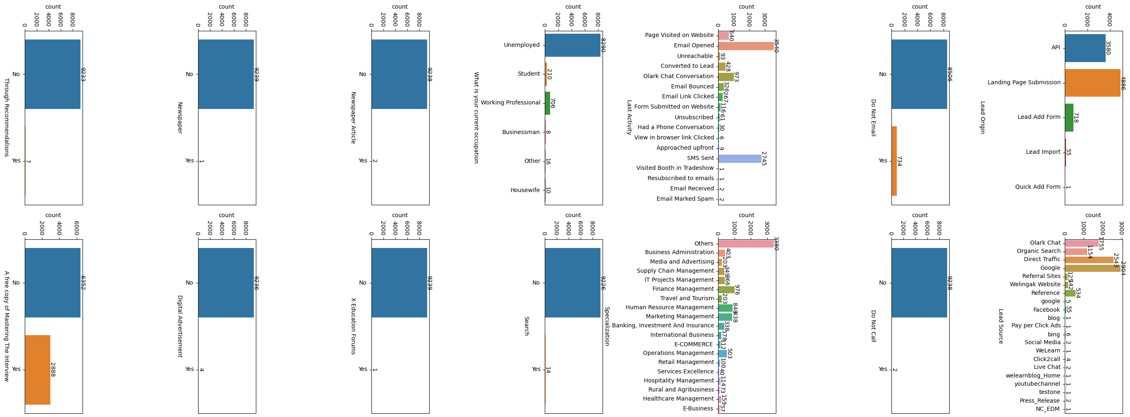
3.4 : Checking & Dropping Category Columns that are Skewed

Slide 9
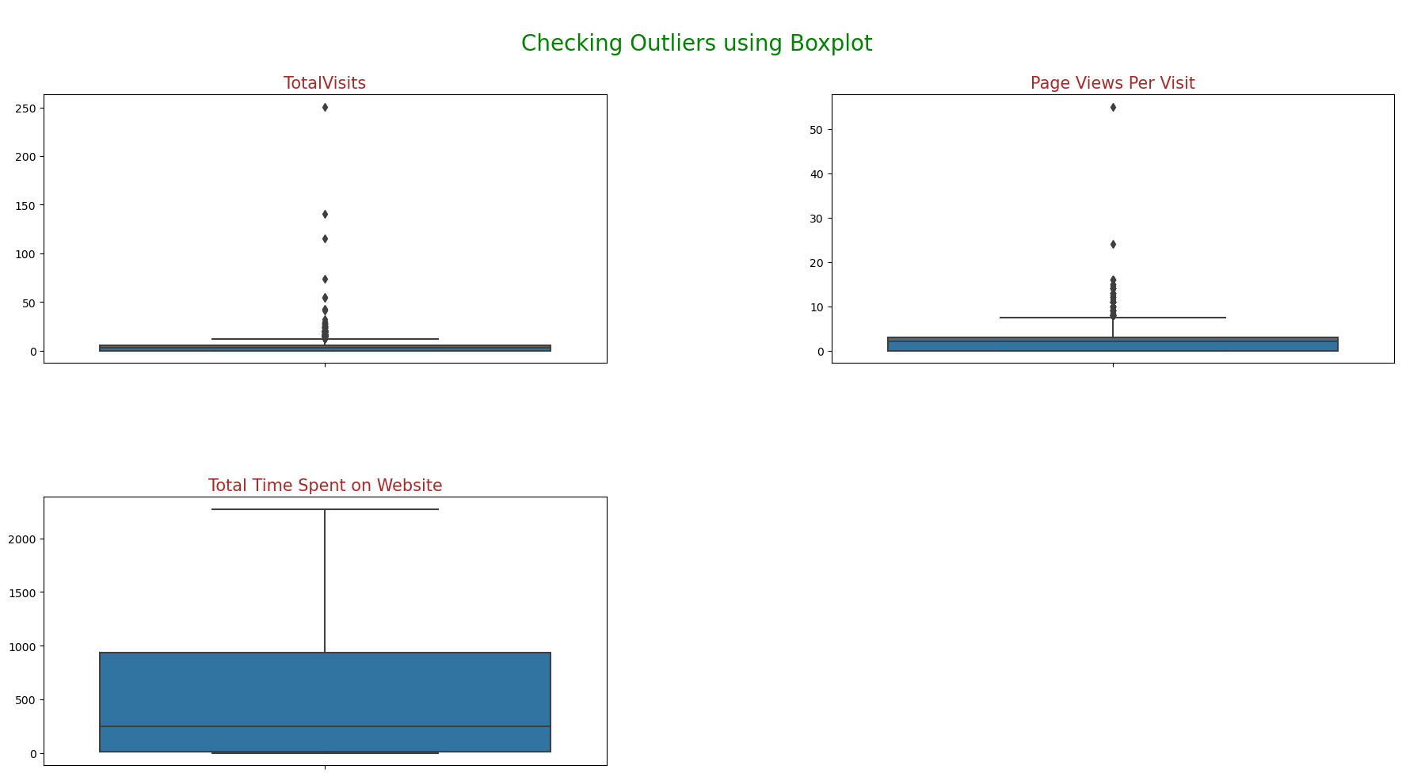
3.5 : Outlier Analysis

Slide 10
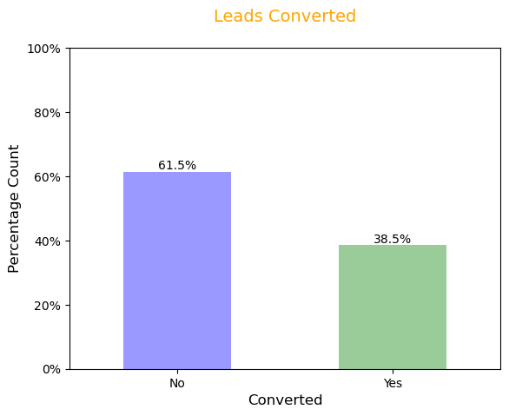
Step 4: EDA:

Slide 11
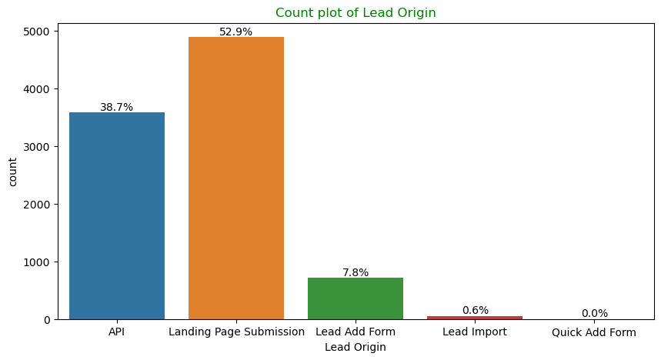
Univariate Analysis

Slide 12
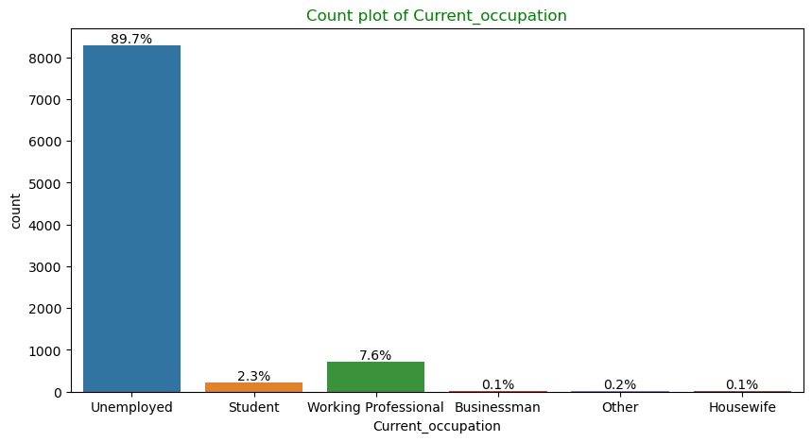

Slide 13
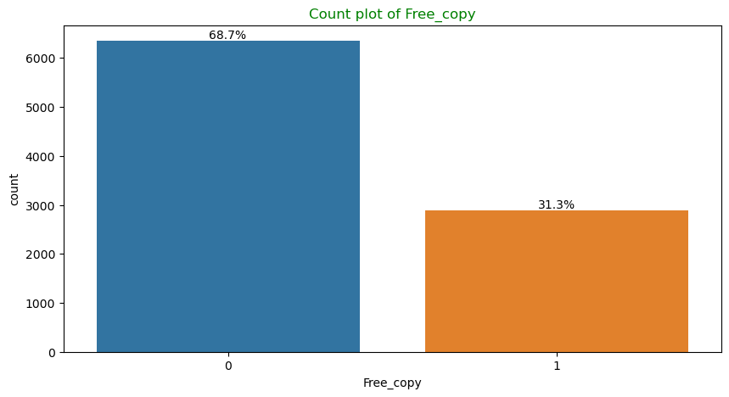

Slide 14
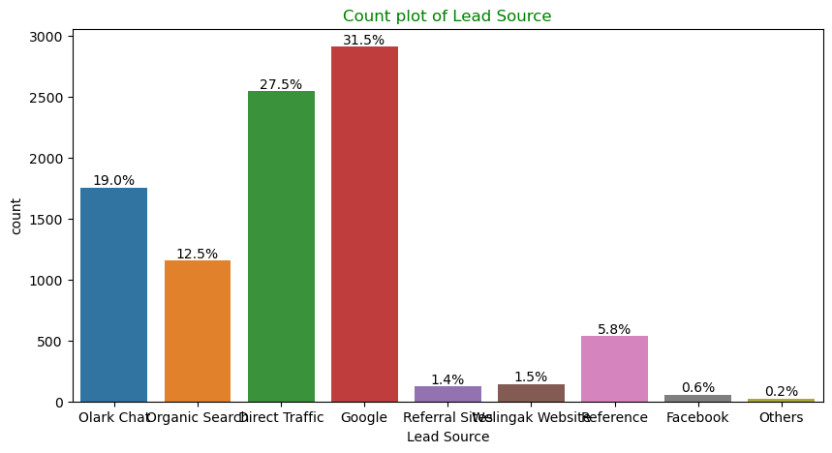

Slide 15
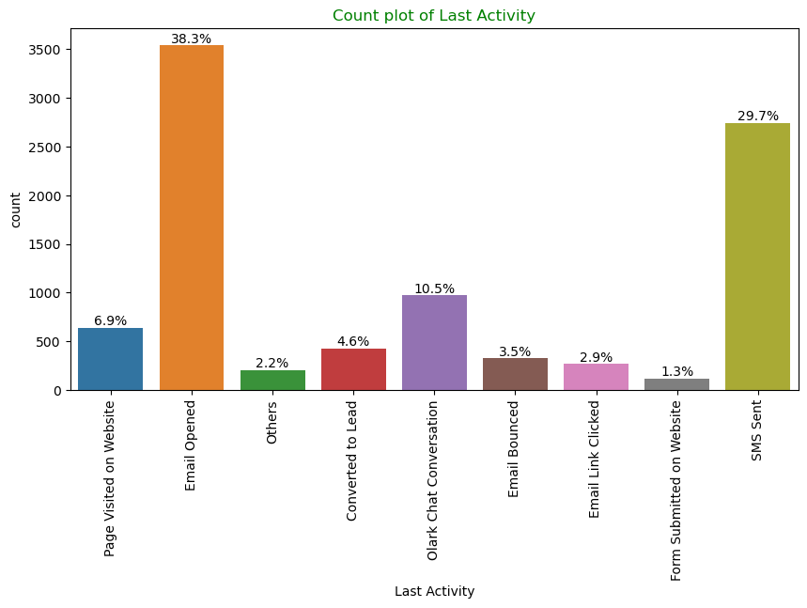

Slide 16
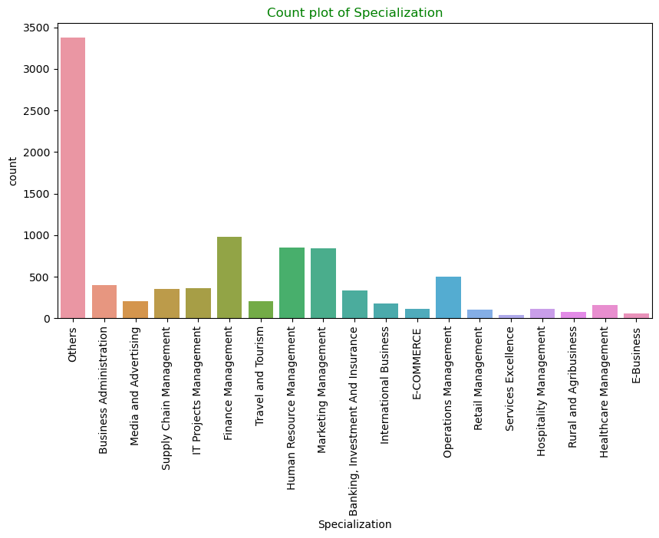

Slide 17
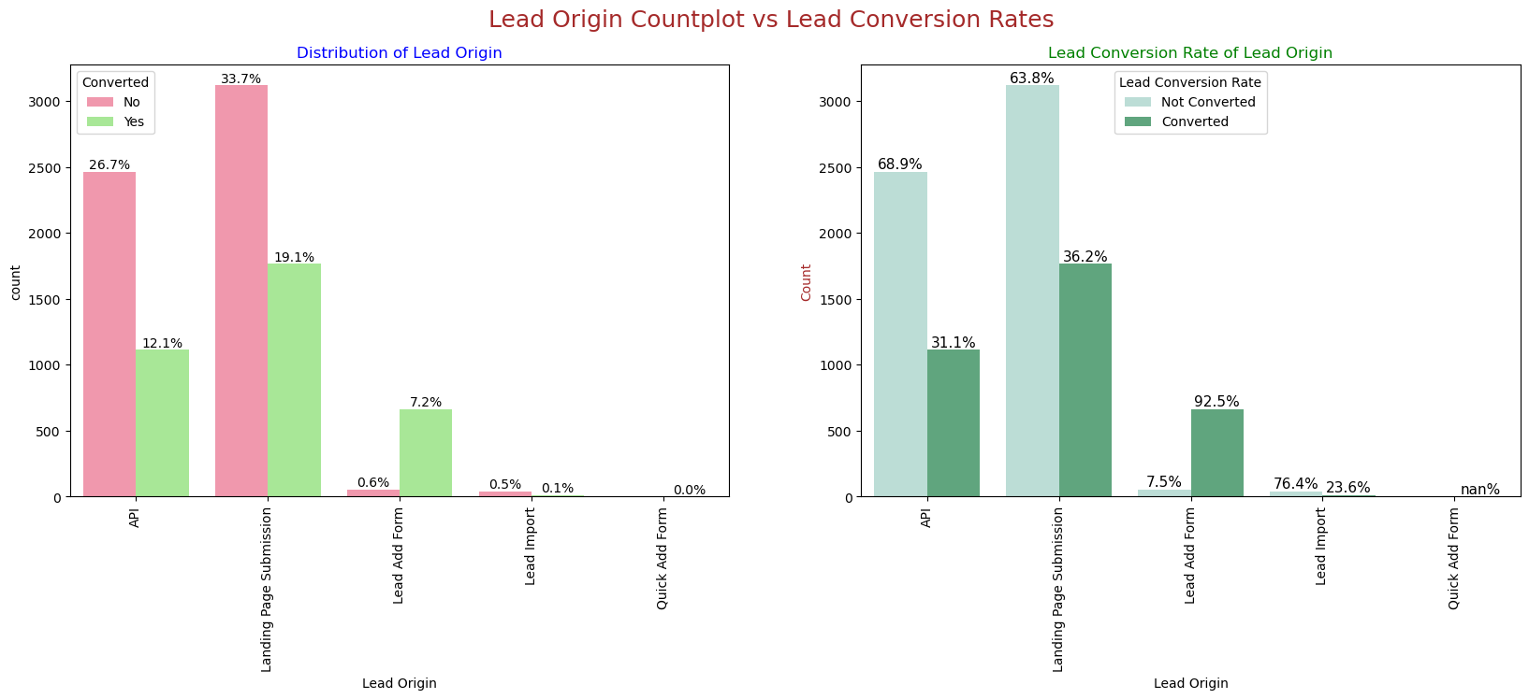
4.3 Bivariate Analysis

Slide 18
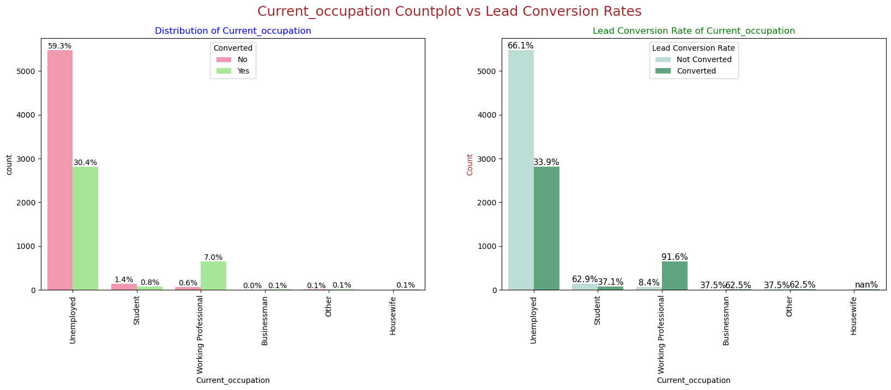

Slide 19
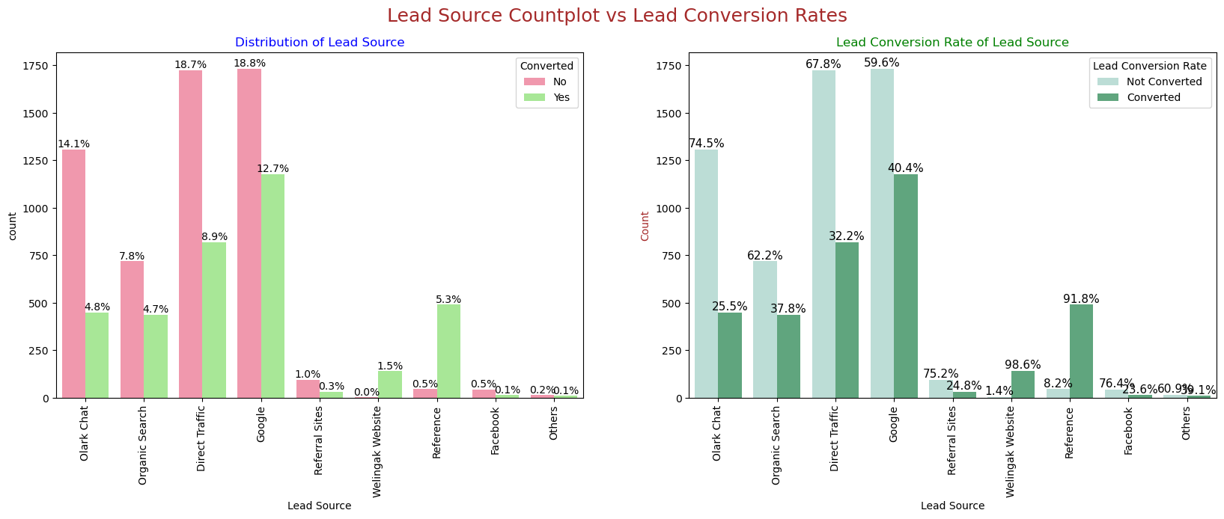

Slide 20
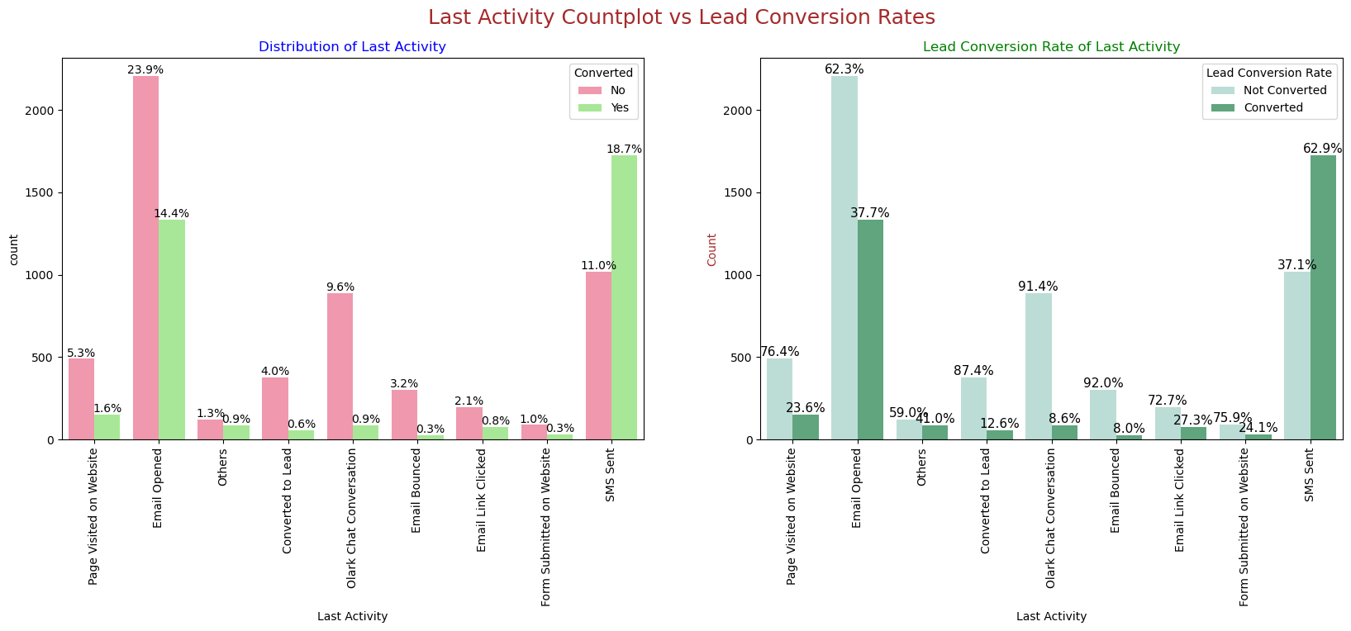

Slide 21
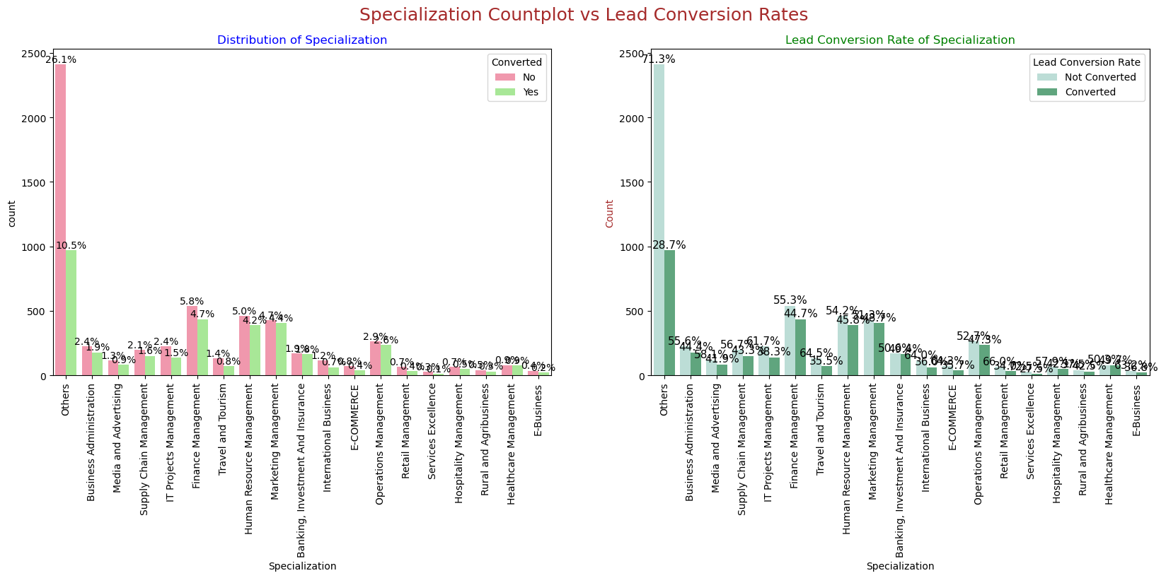

Slide 22
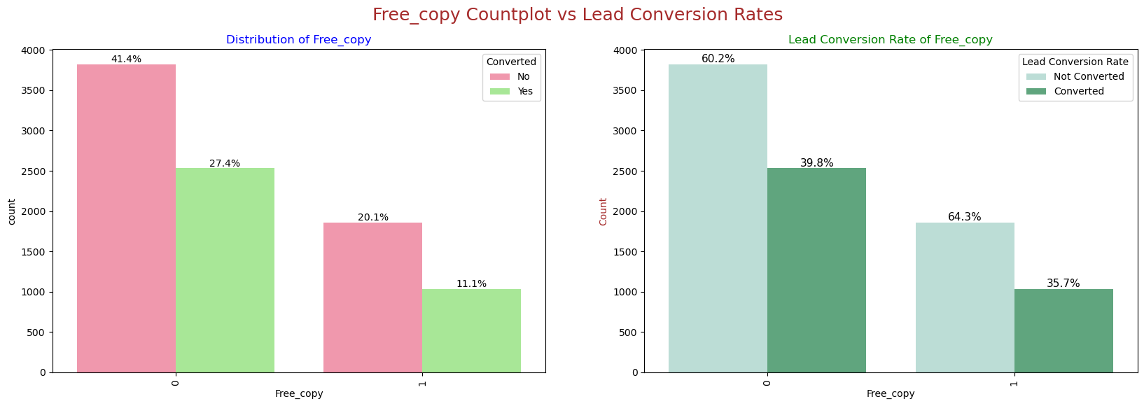

Slide 23
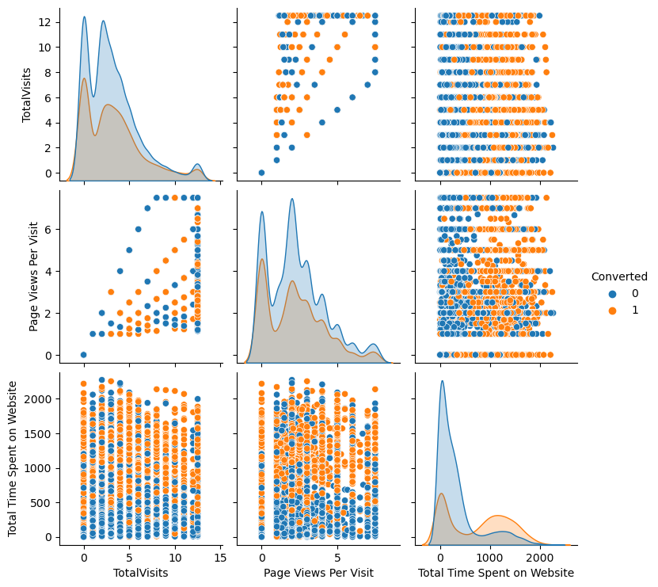
4.3.2 Bivariate Analysis for Numerical Variables

Slide 24
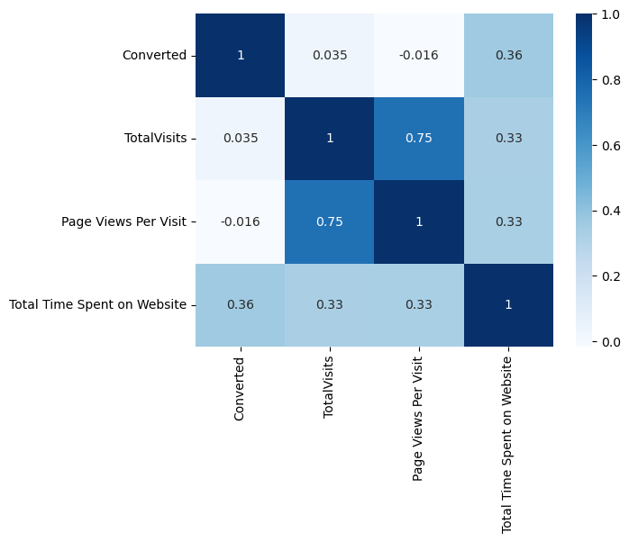
Heatmap to show correlation between numerical variables

Slide 25
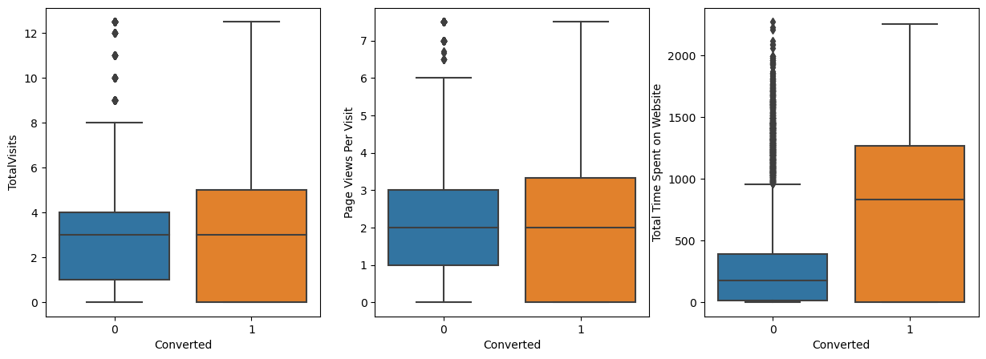
Boxplot

Slide 26
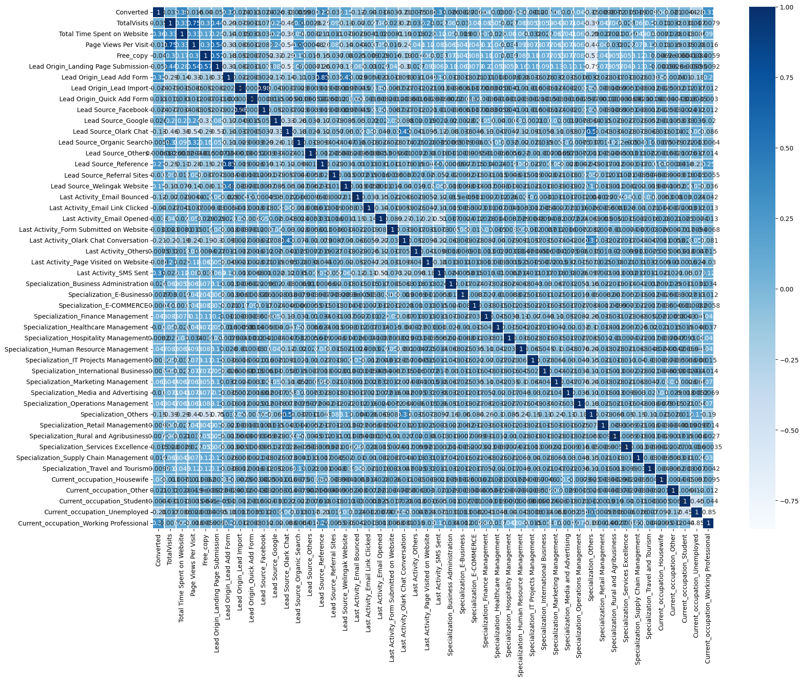
Step 7: Feature Scaling
Looking at Correlation

Slide 27
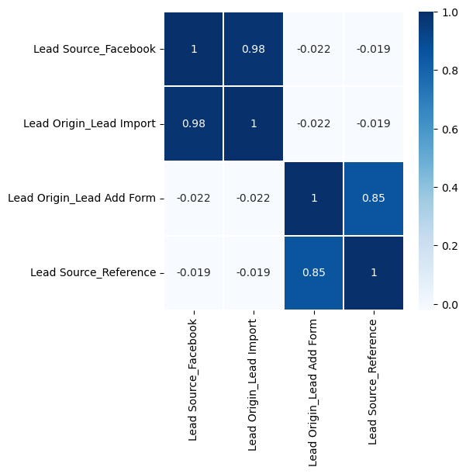

Slide 28
Step 8: Model Building:
Model 3 is stable and has significant p-values within the threshold (p-values < 0.05)

Slide 29
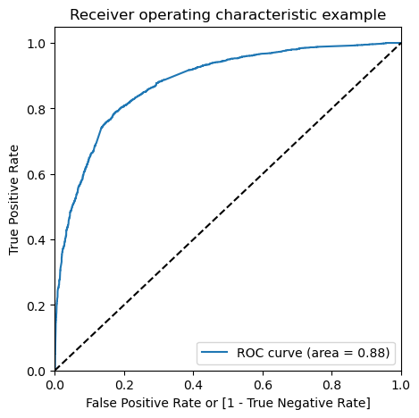
Step 9: Model Evaluation:
Plotting the ROC Curve

Slide 30
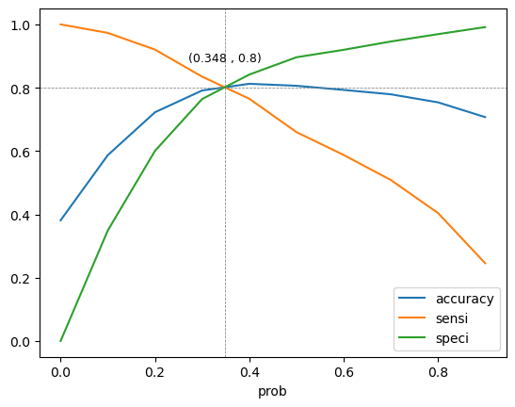
plot accuracy sensitivity and specificity for various probabilities

Slide 31
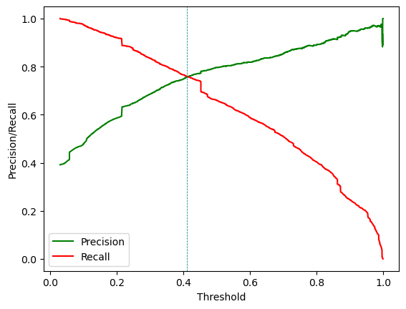
Precision and recall tradeoff

Slide 32
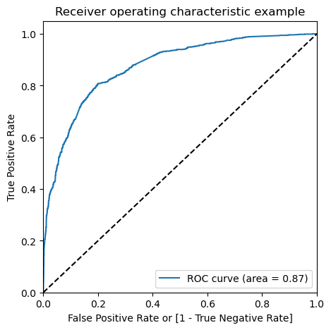
Drawing ROC curve for Test Set

Slide 33
Step 10: Making Predictions on Test Data:
Top 3 features that contributing positively to predicting hot leads in the model are:
Lead Source_Welingak Website
Lead Source_Reference
Current_occupation_Working Professional

Slide 34
Recommendations
Engage working professionals with tailored messaging.
More budget/spend can be done on Welingak Website in terms of advertising, etc.
Incentives/discounts for providing reference that convert to lead, encourage providing more references.
Working professionals to be aggressively targeted as they have high conversion rate and will have better financial situation to pay higher fees too.

